Slide 1
Theories of Economic Growth and Development

Slide 2
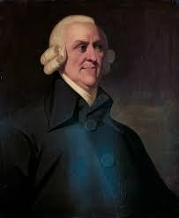

Slide 3
Classical Theory of Development by Smith
Adam Smith proposes natural law in economic affairs.
He advocated the philosophy of free and independent action.
If every individual member of society is left to peruse his economic activity, he will maximize the output to the best of his ability.
Freedom of action brings out the best of an individual which increases society wealth and progress. Adam Smith opposed any government intervention in industry and commerce.

Slide 4
Natural Law
He opines that natural laws are superior to law of states.
Statutory law or manmade law can never be perfect and beneficial for the society, that is why Smith respects nature’s law because nature is just and moral.
Nature teaches man the lesson of morality and honesty. These exercise favorable effects on the economic progress of society.

Slide 5
Laissez Faire
Adam Smith’s theory is based on the principle of ‘Laissez-Faire’ which requires that state should not impose any restriction on freedom of an individual.
The policy of laissez-faire allows the producers to produce as much they like, earn as much income as they can and save as much they like.

Slide 6
Adam Smith believed that it is safe to leave the economy to be propelled, regulated and controlled by invisible hand i.e. the forces of competition motivated by self interest be allowed to play their part in minimizing the volume of savings for development.

Slide 7
Production function by Smith
Y = f (K, L, N)
K = Capital
L = Labour force
N = Land

Slide 8
He emphasized labour as an important factor of production along with other factors.
Prof. Adam Smith regarded labour as father and land as mother.
He wrote, “To him (farmer) land is the only instrument which enables him to earn the wages of his labour and to make profits of this stock”.

Slide 9
Adam Smith asserted that division of labour does not depend merely on technological feasibility, it greatly depends on the extent of the market as well and the size of market depends on the available stock and the institutional restrictions placed upon both domestic and international trade.

Slide 10
Smith also recognizes the importance of technological development for improvement in productivity and which is possible only if sufficient capital is available.

Slide 11
Division of Labour
The rate of economic growth is determined by the size of productive labour and productivity of labour.
The productivity of labour depends upon technological progress of a country and which, in turn, depends upon the division of labour.
This division of labour becomes the true dynamic force in Adam Smith’s theory of growth.

Slide 12
Division of labour increases the productivity of labour through specialization of tasks.
When a work is sub-divided into various parts and the worker is asked to perform small parts of whole job, his efficiency increases as now he can focus his attention more carefully.

Slide 13
Thus, the concept of division of labour means the transference of a complex production process into number of simpler process in order to facilitate the introduction of various methods of production.
Adam Smith concentrated upon the social division of labour which emphasized the co-operation of all for satisfaction of the desires of each.

Slide 14
Benefits of Division of Labour by Smith
Increase of dexterity of workers.
Saving time required to produce commodity.
Invention of better machines and equipment.
Division of labour leads to exchange of goods which, in turn, promotes trade and widens the extent of market. Wide extent of market is an essential pre- requisite for economic development.

Slide 15
Capital Accumulation
It is the pivot around which the theory of economic development revolves.
The growth is functionally related to rate of investment.
According to Smith, “any increase in capital stock in a country generally leads to more than proportionate increase in output on account of continually growing division of labour”.

Slide 16
Capital stock consists of:
Goods for the maintenance of productive workers.
Goods for helping the workers in their productive activities.

Slide 17
Adam Smith distinguished between non capital, circulating capital and fixed capital goods.
Non capital goods refer to those which are useful directly and immediately to their owner.

Slide 18
Fixed capital refers to those goods which are directly used in production processes, without changing hands. Fixed capital consists of all the means of production.
Land, buildings, plant, machinery etc.

Slide 19
Circulating capital is the money being used for core operations of a company.
It includes cash, operating expenses, raw materials, inventory in process.
This is also referred to as working capital.

Slide 20
Capital is increased by parsimony and diminished by prodigality and misconduct.
The rate of investment was determined by the rate of saving and savings were invested in full.
The classical economists also believed in the existence of wage fund.
The idea is that wages tend to equal to the amount necessary for the subsistence of labourers.

Slide 21
If the total wages at any time become higher than subsistence level, the labour force will increase, competition for employment will become keener and the wages come down to the subsistence level.
Thus, Smith believed that, “under stationary conditions, wage rate falls to the subsistence level, whereas in periods of rapid capital accumulation, they rise above this level.

Slide 22
The extent to which they rise depends upon the rate of population growth”.
Thus, it can be concluded that wage fund could be raised by increasing the rate of net investment.

Slide 23
Free Trade
Free trade refers to policies that permit inexpensive imports and exports, without tariffs or other trade barriers.
In a free trade agreement, a group of countries agrees to lower their tariffs or other barriers to facilitate more exchanges with their trading partners.
The agreement between the United States, Mexico, and Canada, known as the North American Free Trade Agreement (NAFTA) is one of the example of free trade.

Slide 24
Smith theory of development is shown in the next page.

Slide 25
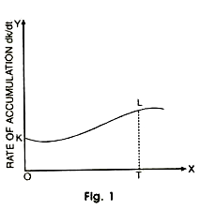

Slide 26
Time is taken along the X-axis and the rate of accumulation along the Y-axis.
The economy grows from K to L during the time path T.
After T, the economy reaches stationary state.
Linked to L where further growth does not take place because wages rise so high that profits become zero and capital accumulation stops.

Slide 27
According to Smith, “investments are made because the capitalist want to earn profits on them. When a country develops and its capital stock expands, the rate of profit declines.
The increasing competition among capitalists raises wages and tends to lower profits”. So it is a great difficulty of finding new profitable investment outlets that leads to falling profits.

Slide 28
Smith wrote that with the increase in prosperity, progress and population, the rate of interest falls and as a result, capital is augmented. With the fall in interest rate, the money lenders will lend more to earn more interest for the purpose of maintaining their standard of living at the previous level.

Slide 29
Thus, the quantity of capital for lending will increase with the fall in rate of interest.
But when the rate of interest falls considerably, the money lenders are unable to lend more in order to earn more to maintain their standard of living.

Slide 30
Trade Cycle
A trade cycle refers to fluctuations in economic activities specially in employment, output and income, prices, profits etc.
Understanding business cycles allows owners to make informed business decisions. By keeping a finger on the economy's pulse and paying attention to current economic projections, they can speculate when to prepare for a contraction and take advantage of the expansion.

Slide 31
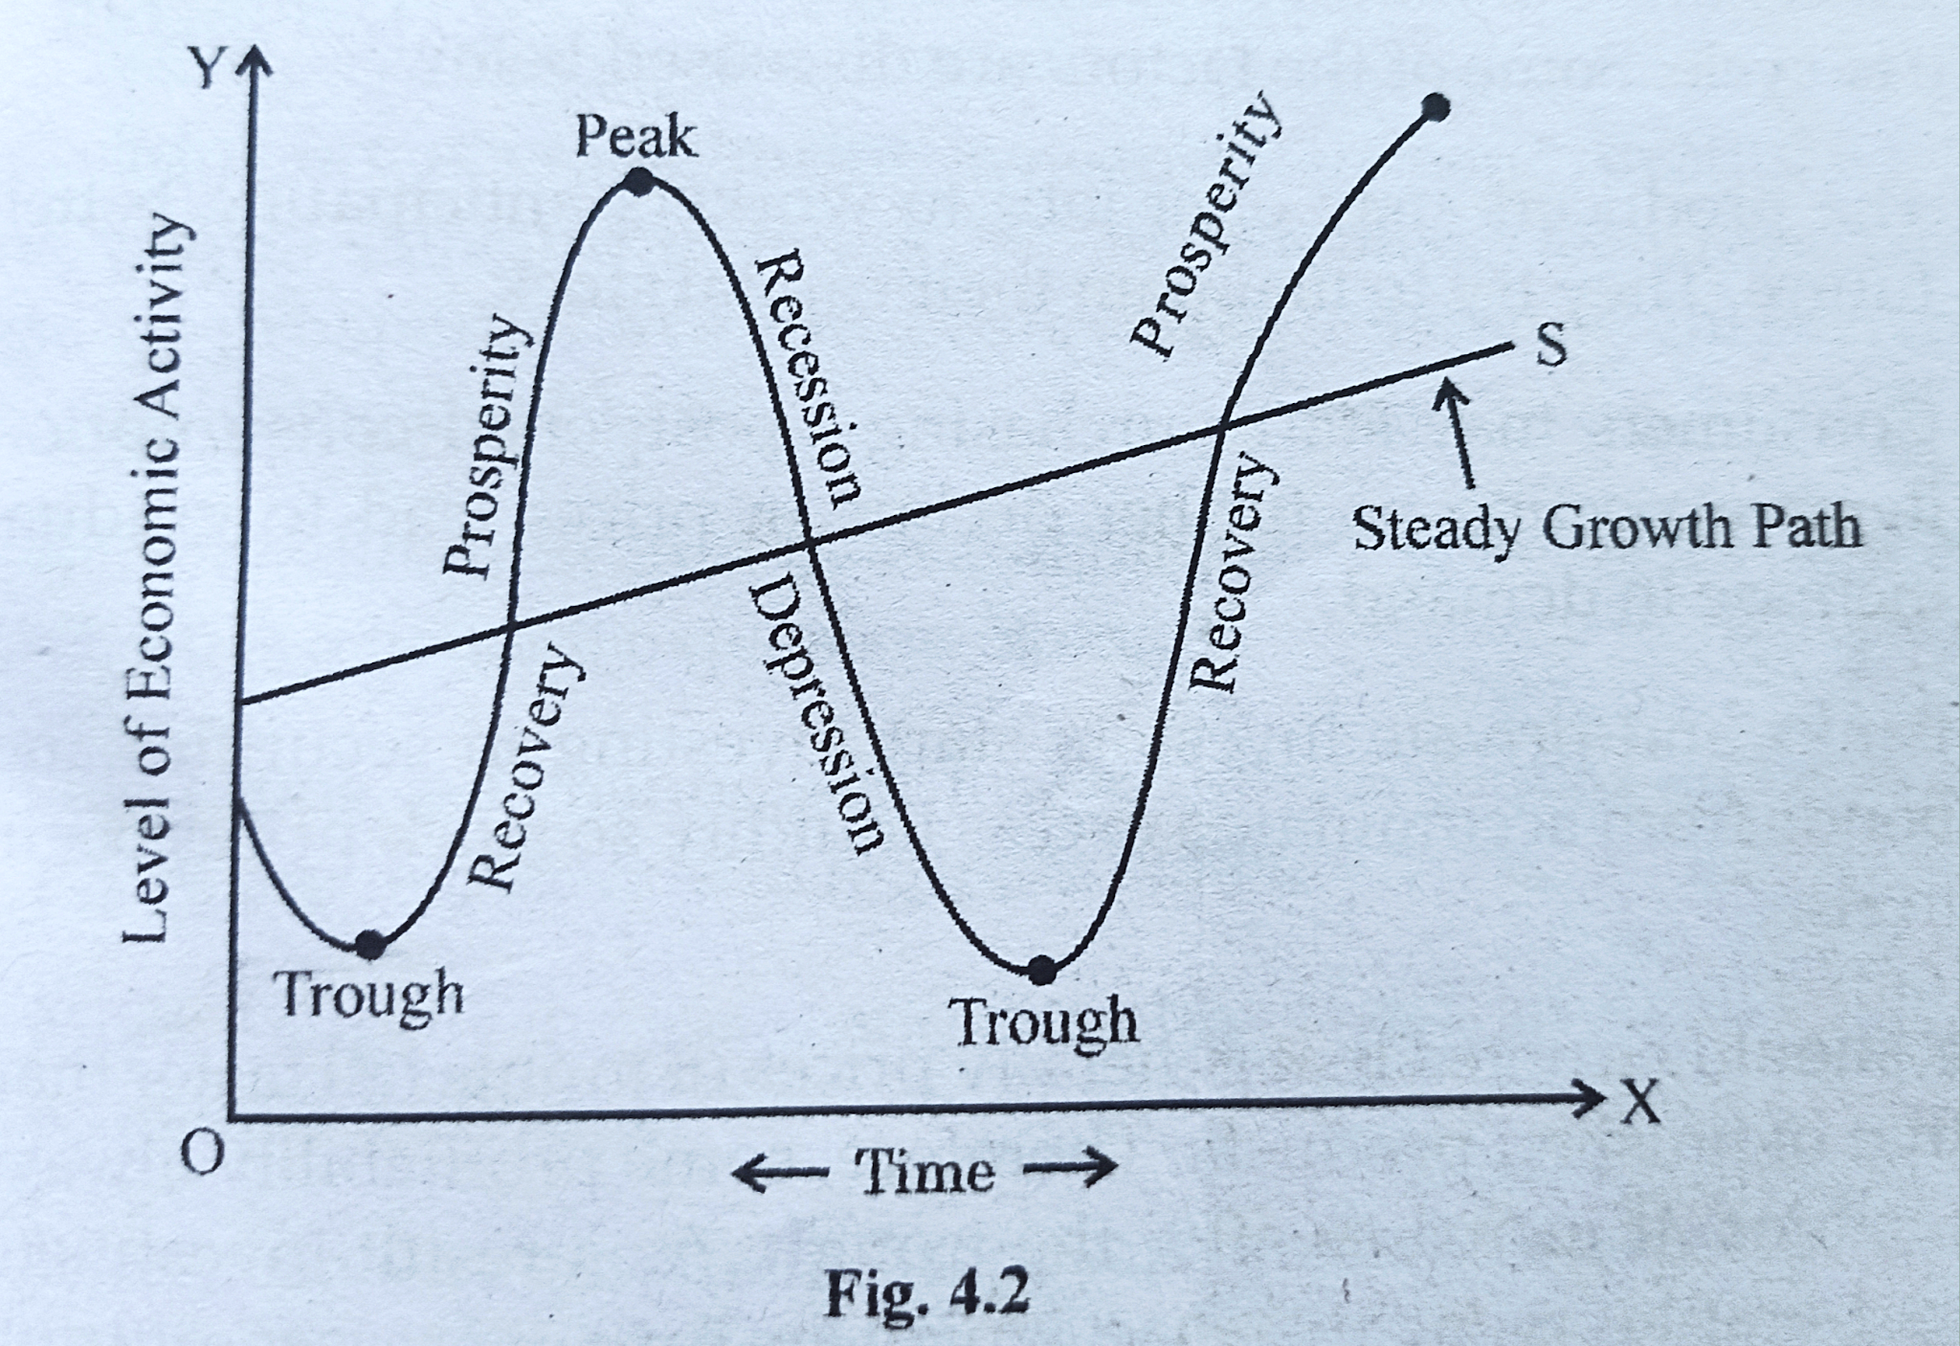

Slide 32
https://www.economicsdiscussion.net/economics-2/adam-smith-theory-of-development-in-economics-main-features/4514
https://www.economicsdiscussion.net/economic-development/theories-economic-development/ricardos-theory-of-economic-development-economics/30044
https://www.studocu.com/in/document/mahatma-gandhi-university/macro-economics/david-ricardos-theory/25176083 (imp)

Slide 33
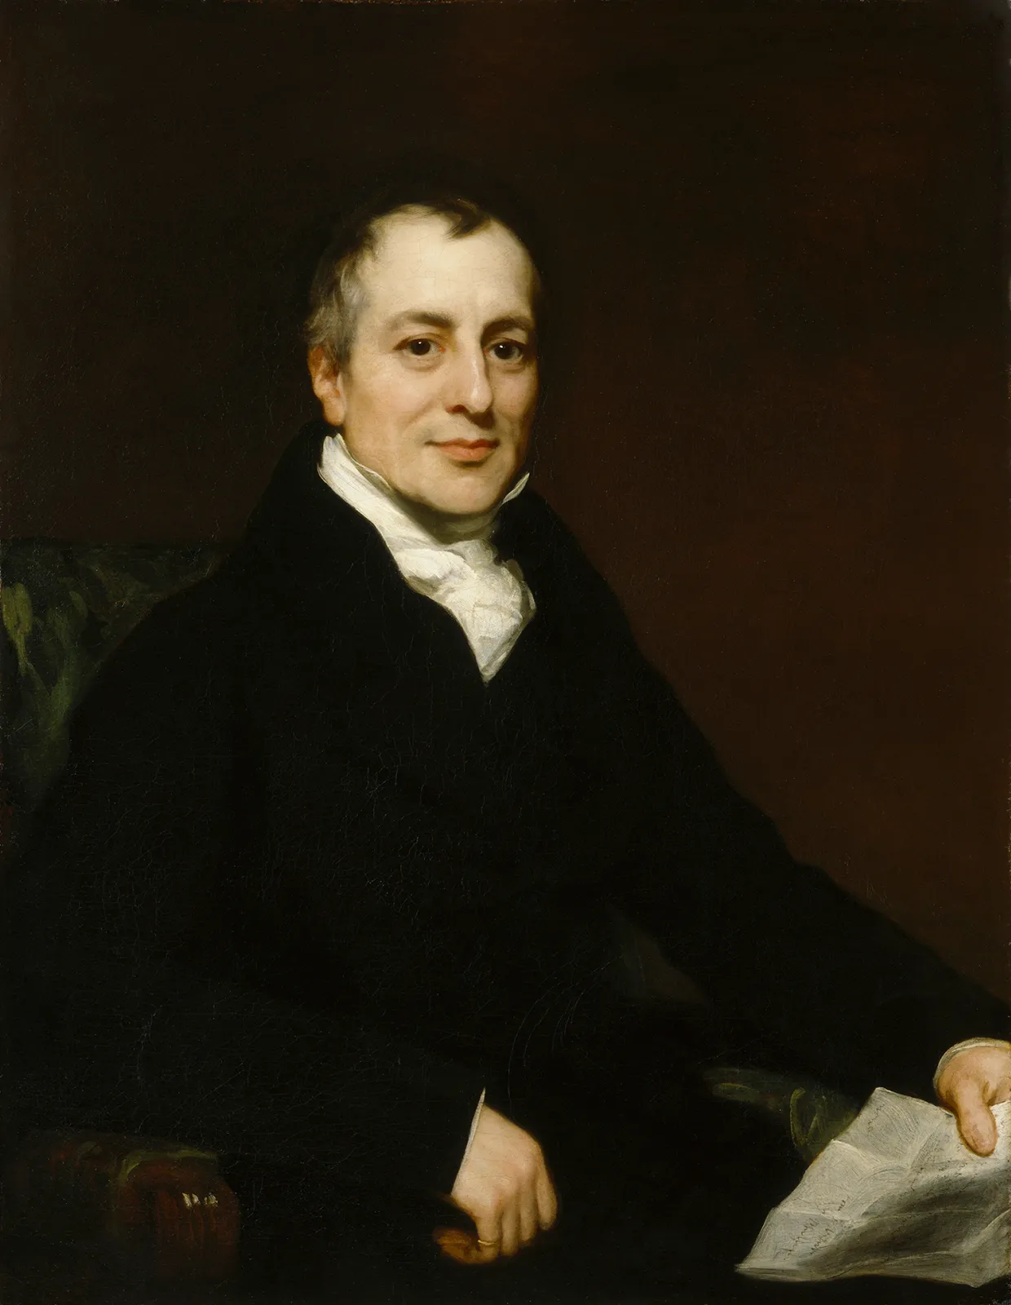

Slide 34
Classical Theory of Development by Ricardo
Prof. Ricardo added little to the economic knowledge gathered by Smith.
He simply discussed the theory of distribution.
The Ricardian theory is based on the interrelations of three groups in the economy.
They are landlords, capitalists and labourers, among who the entire produce of land is distributed, as, rent, profit and wages.

Slide 35
Ricardo’s production function assumes the existence of three factors-land, labour and capital and it is subjected to the restriction of diminishing marginal productivity due to perfectly inelastic of land and its variable quality.
He regarded economic development as the process of these factors of production.

Slide 36
The marginal productivity of land, labour and capital declines with the increase in cultivation.

Slide 37
Production Function by Ricardo
Y = F (K ,N,L)
K = Capital
N = Labour
L = Land

Slide 38
Capital Accumulation
According to Ricardo, capital accumulation is the outcome of profit because profit leads to saving of wealth which is used for capital formation.
Capital accumulation depends on two factors:
The capacity to save
The will to save the capacity to save

Slide 39
The will to save the capacity to save depends upon the net income, which is a surplus out of total output after meeting the cost of workers subsistence.
The larger the surplus, larger will be the capacity to save.

Slide 40
Rent
Rent per unit of land is the difference between the average and marginal product or, total rent equals the difference between the average product and the marginal product of labour multiplied by the quantity of labour and capital applied on land.

Slide 41
Wage
The wage rate is determined by wage fund divided by the number of workers employed at the subsistence level.
The wage rate increases when the prices of commodities forming the subsistence of the workers increase.
The commodities consumed by workers are primarily agricultural products.

Slide 42
As the demand for food increases, less fertile land is brought under cultivation. For this purpose, to produce a unit of the product more labourers are required.
The demand for labour starts rising, which, raises wages. Moreover, to match the increasing cost of subsistence, money-wages will also continue to rise.
Thus wages would rise with the increase in the price of agricultural products and then profits would decline.

Slide 43
Profit
The rate of profit is equal to the ratio of profits to capital employed. But since capital consists only of working capital, it is equal to the wage bill.
So long as the rate of profit is positive, capital accumulation will continue.
The labour force will grow proportionately and the total wage fund will also increase. In reality, profit depends on wages, wages on the price of the agricultural output which depends on the fertility of the marginal land.

Slide 44
There is an inverse relation between profits and wages, and wages rise or fall in keeping with the price of the output.
When there are improvements in agriculture, the productive power of land increases this results in the fall in the price.
As a result, the subsistence wage also falls, but profits increase and there is more capital accumulation.

Slide 45
This will increase the demand for labour and the wage rate will rise resulting in decline in the profit.

Slide 46
In such a situation, rent also increases which absorbs the rise in the price of the products.
This results in increase in wages leading to decline in the ratio of capitalist’s profits.
This results in fall in the capital accumulation.

Slide 47
Profit in other Industries
According to Ricardo, “The profits of the farmer regulate the profits of all other trades”.
Ricardo uses agricultural profits as a basis and it is the agricultural profit which determines the industrial profit.
Thus, when the profit declines in the agricultural sector, it also declines in the industrial sector.

Slide 48
The industry would have to raise the wages of labourers with the increase in price of agricultural output and which in turn, reduces the profit.
Thus, the price of agricultural output determines the rate of profit in an industry.
When profit declines in agricultural sector, it declines in all trades.

Slide 49
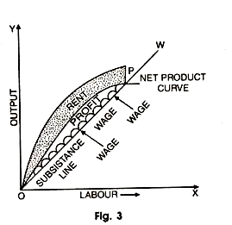

Slide 50
With the increase in capital accumulation, profits and wages tend to increase and the rise in wages bring about a decline in profits.
The decline in profits will continue till a stage comes when the net product curve intersects the wage line OW at P. At this point, wages are equal to net product and the profit is nil.
Any disturbance to the right of point P, will make the net product less than wage level which is impossible. So P is the point at which economy is in a stationary state.

Slide 51
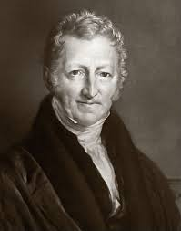

Slide 52
Malthus Theory of Development
Malthus contends that the process of economic development is not automatic. Rather conscious, deliberate efforts are needed to bring it about.
Malthus explains that mere increase in population cannot by itself lead to economic development unless there is increase in effective demand.

Slide 53
Malthus’s important contribution is in showing that savings in the sense of not consuming is a mere negative act and instead of creating more demand it will lead to a decline in effective demand.
Only savings which are furnished by increased gains and are invested create an effective demand.

Slide 54
Malthus brings out an important fact that in advanced economy, consumption, saving and investment all should expand simultaneously.

Slide 55
Role of Capital
Malthus has given more importance to the accumulation of capital for economic development.
He regards capital as indispensable to development.
According to him, “no permanent and continued increase of wealth can take place without a continued increase of capital.”

Slide 56
Malthus underlined the importance of foreign trade for speeding up economic development.
Foreign trade provides incentives for investing, since it leads to the extension of the market for the goods produced and for greater division of labour resulting in increased output.

Slide 57
One important fact was brought by Malthus, that as the economy moves forward, there is decline in the relative importance of agriculture.
Naturally, agriculture disappears by the speedier development of industries, as in developing countries, Economic development is regarded as synonymous with the development of industries.

Slide 58
So, Malthus suggested for land reform for the expansion of agricultural output.
That’s why Malthus advocated for dualism in the developing countries.
He envisaged the economy as consisting of the two major sectors, viz., the agricultural sector and the industrial sector.

Slide 59
The law of increasing returns operated in the industrial sector, whereas the agricultural sector was subject to the law of diminishing returns, the rate of technological progress being responsible for this difference.

Slide 60
As development of both the sectors are dependent on each other, if one of these sectors lags behind, it retards the development of the other sector.
The development of the industrial sector of underdeveloped countries is limited by the poverty of the agricultural sector. This is due to the fact that the lack of purchasing power in the rural masses reduces effective demand in the economy and retards its growth.

Slide 61
Assessment of Malthus’s Contributions:
There is no doubt that Malthus made a valuable contribution to the theory of economic development.
A great deal of what he wrote on the subject is applicable to an underdeveloped economy, especially relating to the theory of dualism.

Slide 62
It has been pointed out by the critics of Malthus’s theory of economic development; he concentrates on explaining the factors which hinder growth rather than the factors that promote economic progress.

Slide 63
However, some elements of his theory make positive contribution to the growth process. For example, he considers production and distribution as the two grand elements of economic growth.

Slide 64
policy implications to promote economic development by Malthus
Balanced Growth
Raising Effective Demand

Slide 65
Balanced Growth
Malthus opined, an economy consisting of two sectors i.e. industrial and agricultural.
It is the technological progress which can lead to economic development in both sectors.
The agricultural output is subject to diminishing returns. In such an economy, economic development starts with its capital investment in agriculture.

Slide 66
To avoid the operation of the law of diminishing returns in agriculture, population growth should be absorbed in industrial sector as more opportunities for profitable investment exist only in the industrial sector.
This requires heavy capital investment and rapid technological progress in the industrial sector.
Thus, in a dualistic economy comprising agricultural and industrial sectors, economic development means the balanced growth of both the sectors.

Slide 67
Raising Effective Demand
Technological progress can lead to economic development only when there is increase in effective demand in an economy.

Slide 68
Measures to Increase Effective Demand by Malthus
Equal Distribution of Wealth & Landed Property
Malthus believed that moderately rich people can raise effective demand more than one millionaire among the poor masses.
He favored a more equitable distribution of landed property for that would increase effective demand as well as production.

Slide 69
Expansion of Internal and External Trade
It is the internal as well as external trade that increases wants and desire to consume which are absolutely necessary to keep up market prices of commodities and prevent the fall of profits.
Internal and external trade also increase the value of products exchanging what is wanted less and what is wanted more.

Slide 70
Maintenance of Unproductive Consumers
Unproductive consumers are those persons who do not produce material objects.
The production can be increased by increasing consumption. Since capitalists are parsimonious and productive, workers live upon subsistence wages, unproductive consumption upon the part of unproductive labourers and landlords will increase effective demand.

Slide 71
Public Works Schemes
Malthus suggested public work schemes to remove unemployment and increase the effective demand.
Malthus pointed out, “The employment of people on poor roads and public works and a tendency among landlords and persons of property to build, to improve and beautify their grounds, and to employ workmen and menial servants, are the means to remedy the evils arising from the disturbance in the balance of produce and consumption

Slide 72
https://www.economicsdiscussion.net/economic-growth/measures-to-promote-economic-growth/4528

Slide 73
Rostow’s Theory of Development
Rostow's Model of Economic Development, is a modernisation theory model depicting how countries move from an underdeveloped society to one that is more developed and modern.
Modernisation Theory appeared in the middle of the 20th century as a theory to improve economic development in underdeveloped countries.

Slide 74
According to Rostow, for a country to become fully developed, it must follow 5 particular stages.
The 5 stages of economic growth are:
Stage 1: Traditional Society
Stage 2: Preconditions for Take-off
Stage 3: Take-off
Stage 4: Drive to Maturity
Stage 5: Age of high mass consumption

Slide 75
Stage 1: Traditional Society
The traditional society that Rostow describes is a society that is considered primitive, having no technological or scientific knowledge.
In this stage, a country's industry is characterised by a rural, agricultural and subsistence economy, with little trading and connections with other countries or even within their own nation.
Bartering is a common characteristic of trading in this stage.

Slide 76
Cont.…
Output from production exists, but for Rostow, there will always be a limit on this due to the lack of technology.
This stage shows countries to be very limited, with a low level of development.
Some countries in Sub-Saharan Africa, or smaller pacific islands, are still considered to be in stage 1.

Slide 77
Stage 2: Preconditions for Take-off
In this stage, early manufacturing begins to take off, albeit slowly. For example, more machinery enters the agricultural industry, moving away from purely a subsistence food supply, helping to grow more food and reduce labour intensiveness.
National and international connections start to develop, as well as education, politics, communication, and infrastructure.

Slide 78
Cont.…
For Rostow, this take-off is accelerated by aid or Foreign Direct Investment from the West.
This is also a stage for entrepreneurs, who begin to take risks and make investments.

Slide 79
Stage 3: Take-off
This stage is characterised by industrialisation and rapid and sustainable growth.
Rapidity is essential here, giving the impression of a kind of revolution.
The entrepreneurial elite and the country's creation as a nation-state are vital in this stage.

Slide 80
Cont.…
After this industrialisation, then follows the increase in the production of goods that could then be sold in far-away markets.
Urbanisation also starts to increase as a result of rural-urban migration towards factories in cities.

Slide 81
Cont..
There are vast infrastructure improvements, industries become internationalised, investments in technology are high, and the population becomes wealthier.
Countries that are considered developing countries today are in this stage, such as Vietnam and Thailand.

Slide 82
Stage 4: Drive to Maturity
This stage is a slow process and takes place over a more extended amount of time.
At this stage, the economy is said to be self-sustaining, meaning it essentially supports itself, and economic growth continues naturally.

Slide 83
Cont..
Industries start to develop further, agricultural production goes down, investment increases, technology improves, skills diversify, urbanisation intensifies, and further infrastructural improvements occur.
The economy grows alongside the population's standards of living.
Over time, these improvements keep developing further as new sectors flourish. This economic growth stage can be exampled by the newly emerging economies of the world, such as China.

Slide 84
Stage 5: Age of High Mass Consumption
The final stage of Rostow's model is where many western and developed nations lie, such as Germany, the U.K., or the U.S., characterised by a capitalist political system.
This is a high-production (high-quality goods) and high-consumption society with a dominant service sector.

Slide 85
Cont..
Consumption is beyond the basic level, i.e., no longer consuming what is necessary, like food or shelter, but more luxury items and luxury living.
These powerful countries are characterised by high economic standing and economic growth.

Slide 86
https://www.studysmarter.co.uk/explanations/human-geography/economic-geography/rostow-model/
https://study.com/learn/lesson/rostows-stages-economic-growth-concept-list-criticism.html

